Slide 1
Electric Vehicle ETL Project
We Got No Gas
Beth Gietl
Lori Fraunfelder
Ce’Aren Robinson
Rob Thompson
Lynn Pettis

Slide 2
01
Project Outline
02
Extract / Locating the Data Sources
Locating the original data sources (CSV & HTML)
03
Transform / Data Cleanup & Analysis
Cleaned and transformed the data for analysis.
04
Load / Final Database
CONTENTS
Join data sources into the final database with tables/collections.
05
Project Summary

Slide 3
Project Outline:
We looked at two Electric Vehicle (EV) data sources.
Downloaded CSV file from Kaggle.com
Scraped an HTML article from CarAndDriver.com
We examined and compared the data from the two sources. The sources had similar data; make, model, range, etc.
They also carried unique values separately and through the ETL process we joined the two data sources together to enhance the analysis.

Slide 4
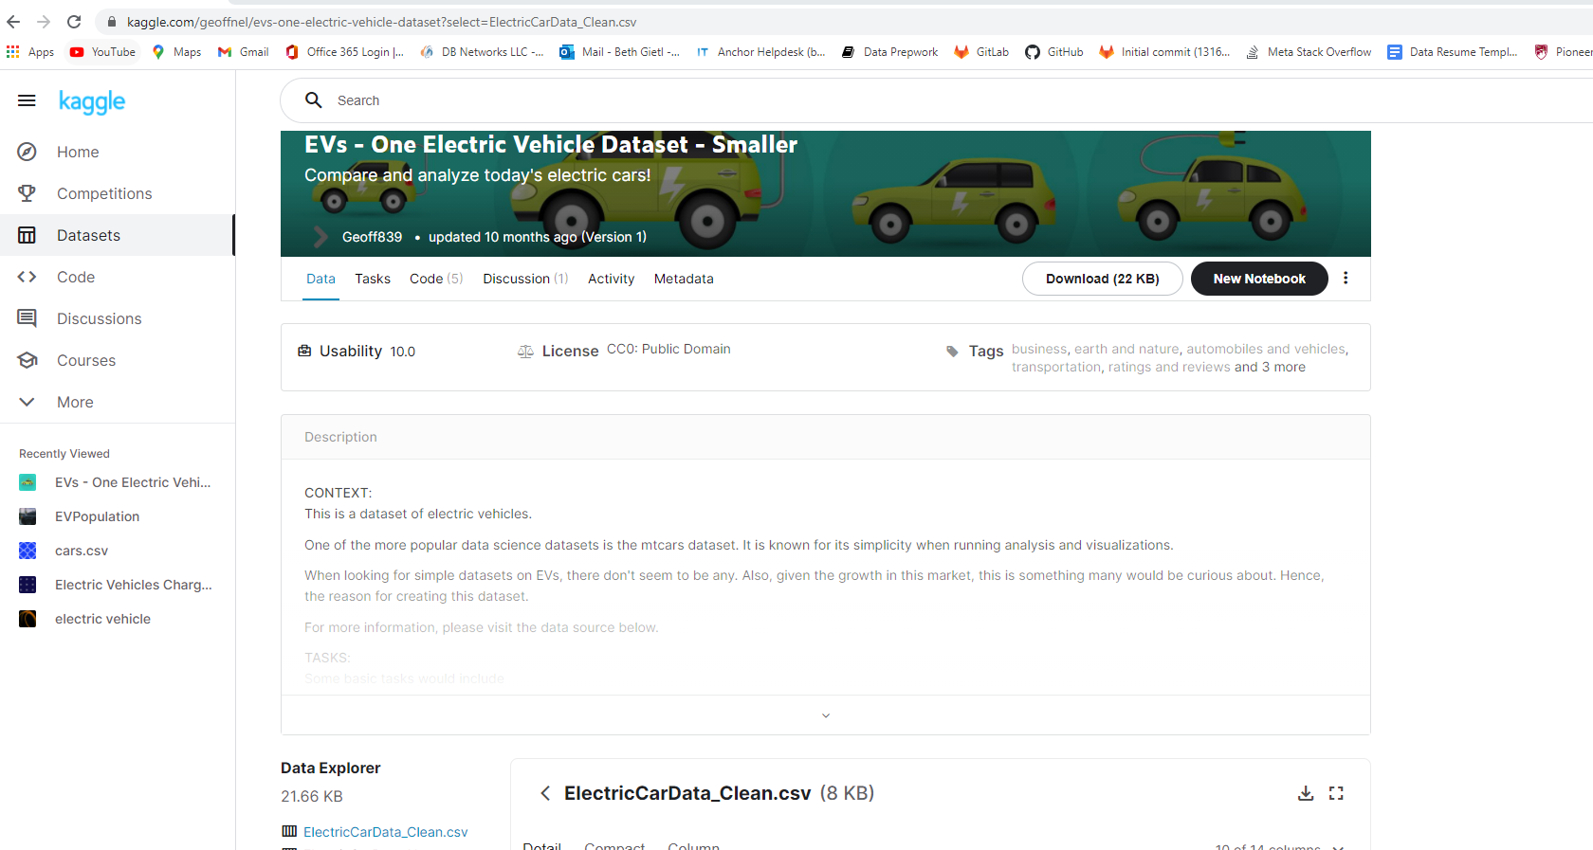

Extract: First Data Source, CSV file

Slide 5
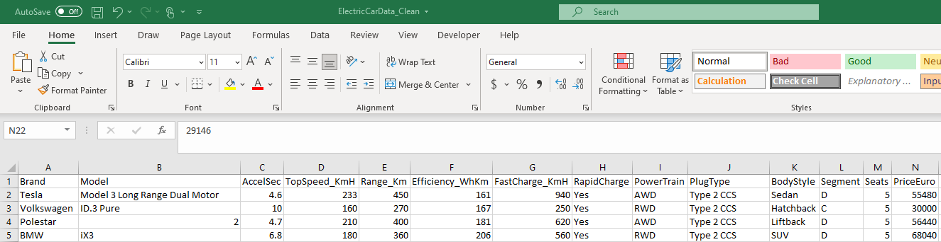
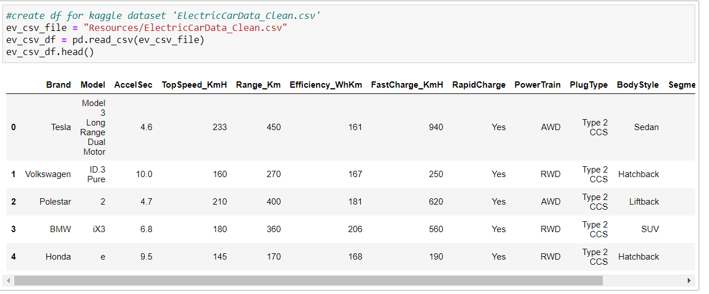
Extract: CSV file to a Pandas DataFrame

Slide 6
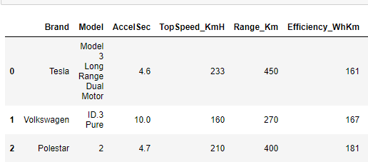
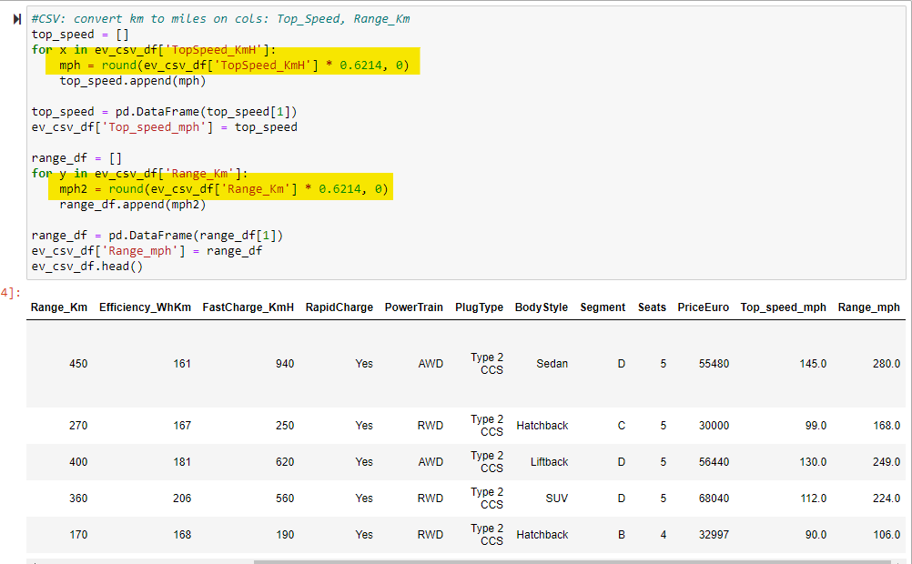
Transform: Clean the CSV DataFrame
Using Pandas we converted the Kilometers per hour in the Top Speed and Range columns to Miles per hour.

Slide 7
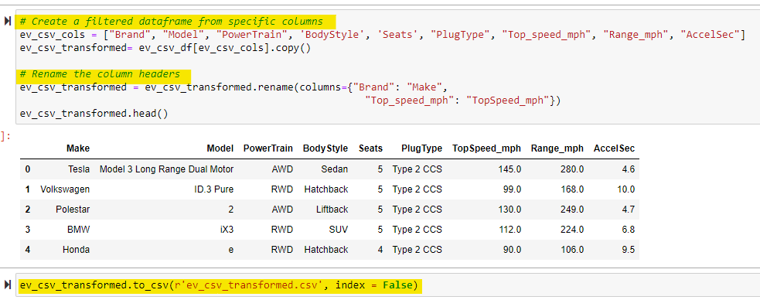
Transform: Clean the CSV DataFrame continued
Using Pandas we transformed the CSV DataFrame:
Created a filtered DataFrame and dropped unnecessary columns
Renamed column headers
Read and Saved the DataFrame to a new CSV file

Slide 8
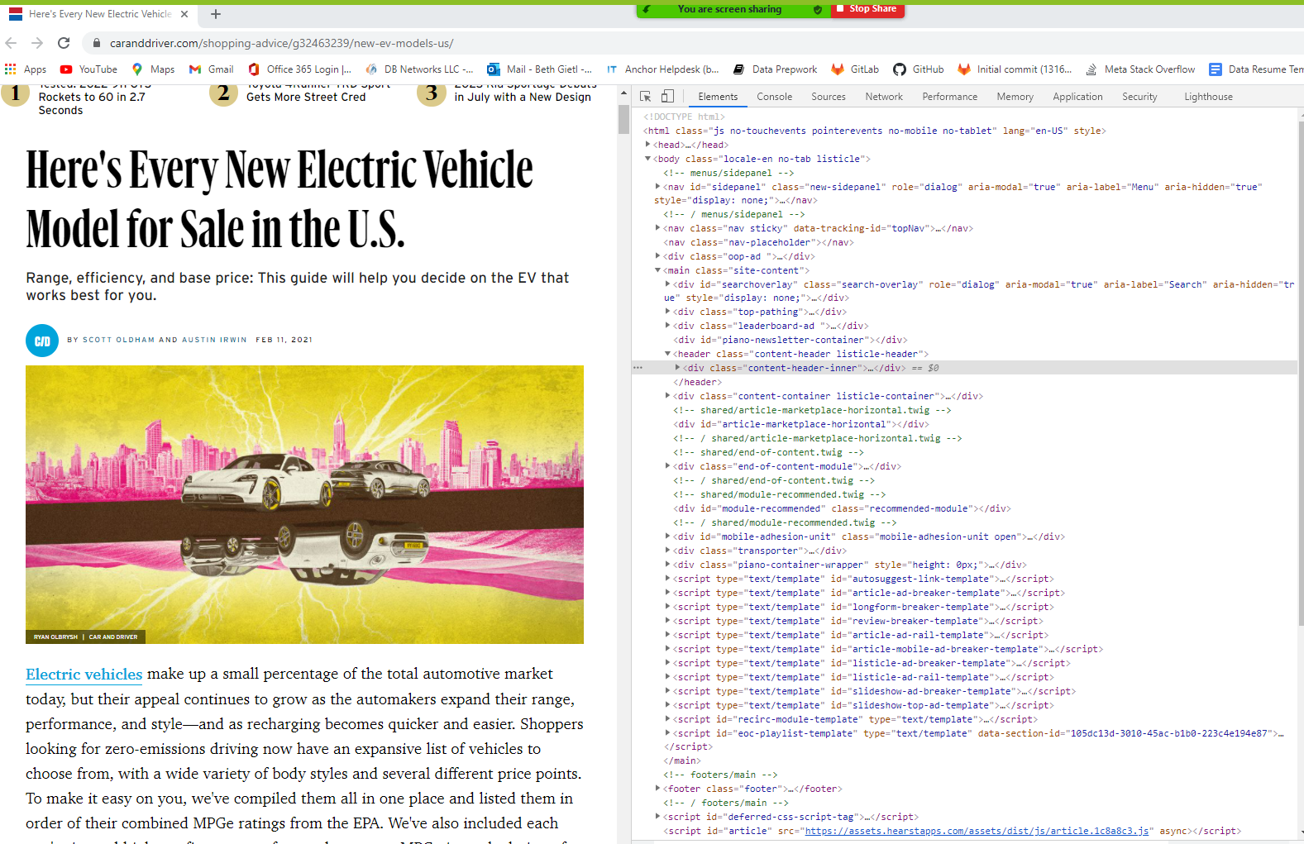
Extract: Second Data Source, HTML Article

Slide 9
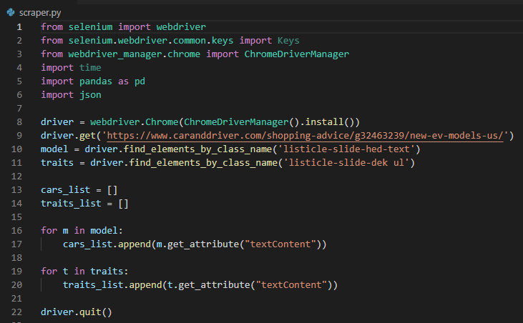
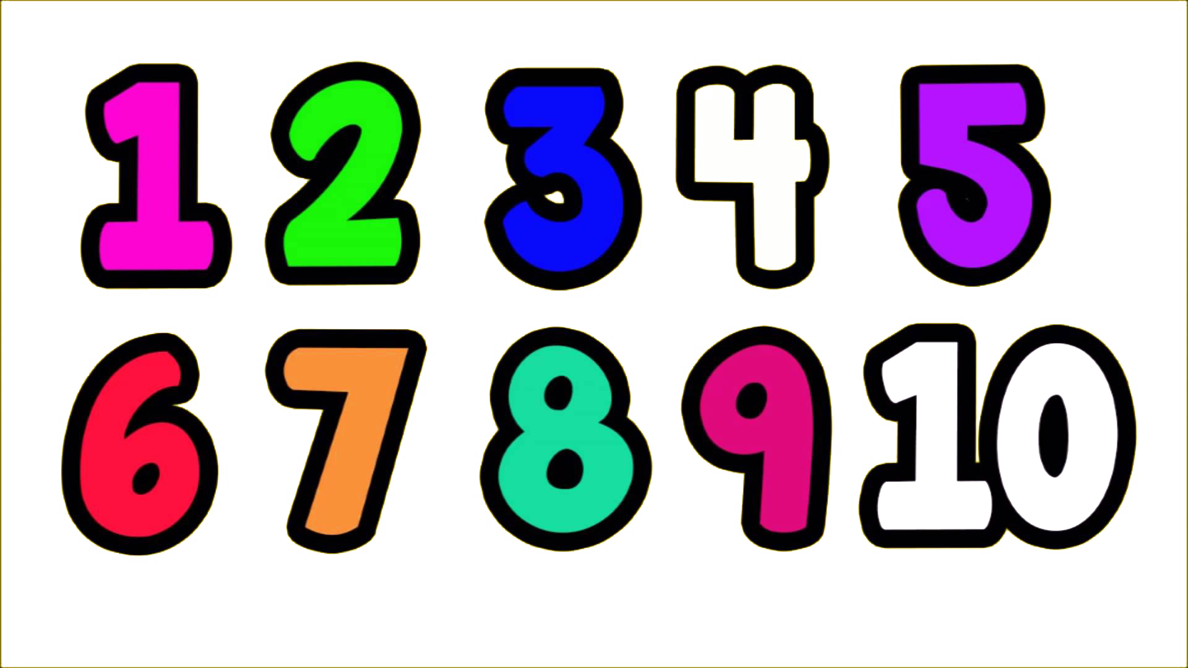

Extract: HTML to Pandas
Scraped the HTML to Pandas.
Created driver variable to access the webpage
Directed the driver variable to obtain the data we were looking for
Created the for loops to assign the data to open lists
Good lesson learned was QUIT THE DRIVER!

Slide 10
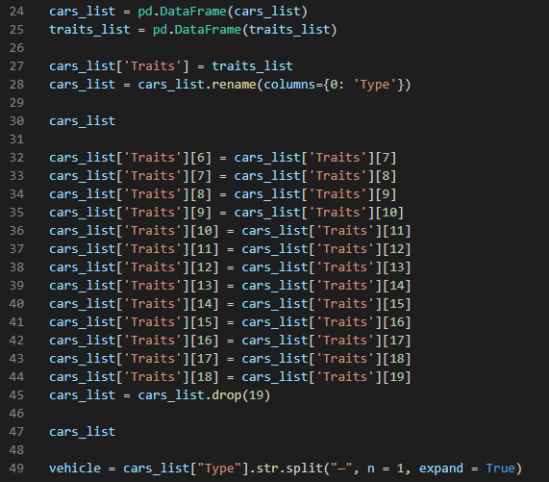
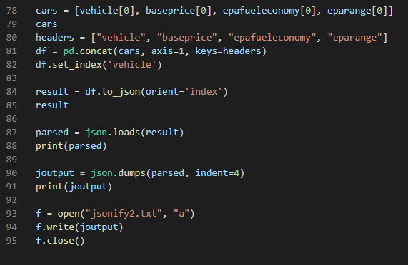

Transform: Pandas to JSON
Scraped the HTML to JSON:
5. Created Pandas DataFrames from the lists
6. Merged the DataFrames to one DataFrame
There were two columns in the Combined Data Frame
“Types”
“Traits” which contained a string of data
During the conversion there were Null values inserted in the cars_list DataFrame and the “Traits” values shifted down one row. Re-numbered the “Traits” with the correct “Type”
Split the string of data in the “Traits” column into component pieces. Split n the dash, colon, and space to extract the necessary data for our transformed DataFrame. Repeated split process for base price, fuel economy, and range
Created a DataFrame composed of the extracted values from the code above
Process of JSONIFY the DataFrame
This Photo by Unknown Author is licensed under CC BY-NC

Slide 11
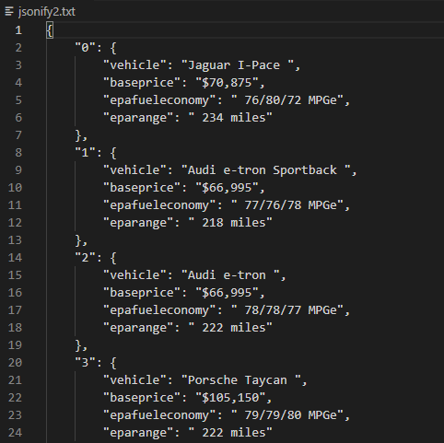
Transform: Pandas to JSON - Output

Slide 12
Load
Load: the final database, tables/collections, and why this was chosen.
Data warehouse
Show or explain the pgAdmin/python connection
Show ERD
Show the final database
Show tables/collections

Slide 13
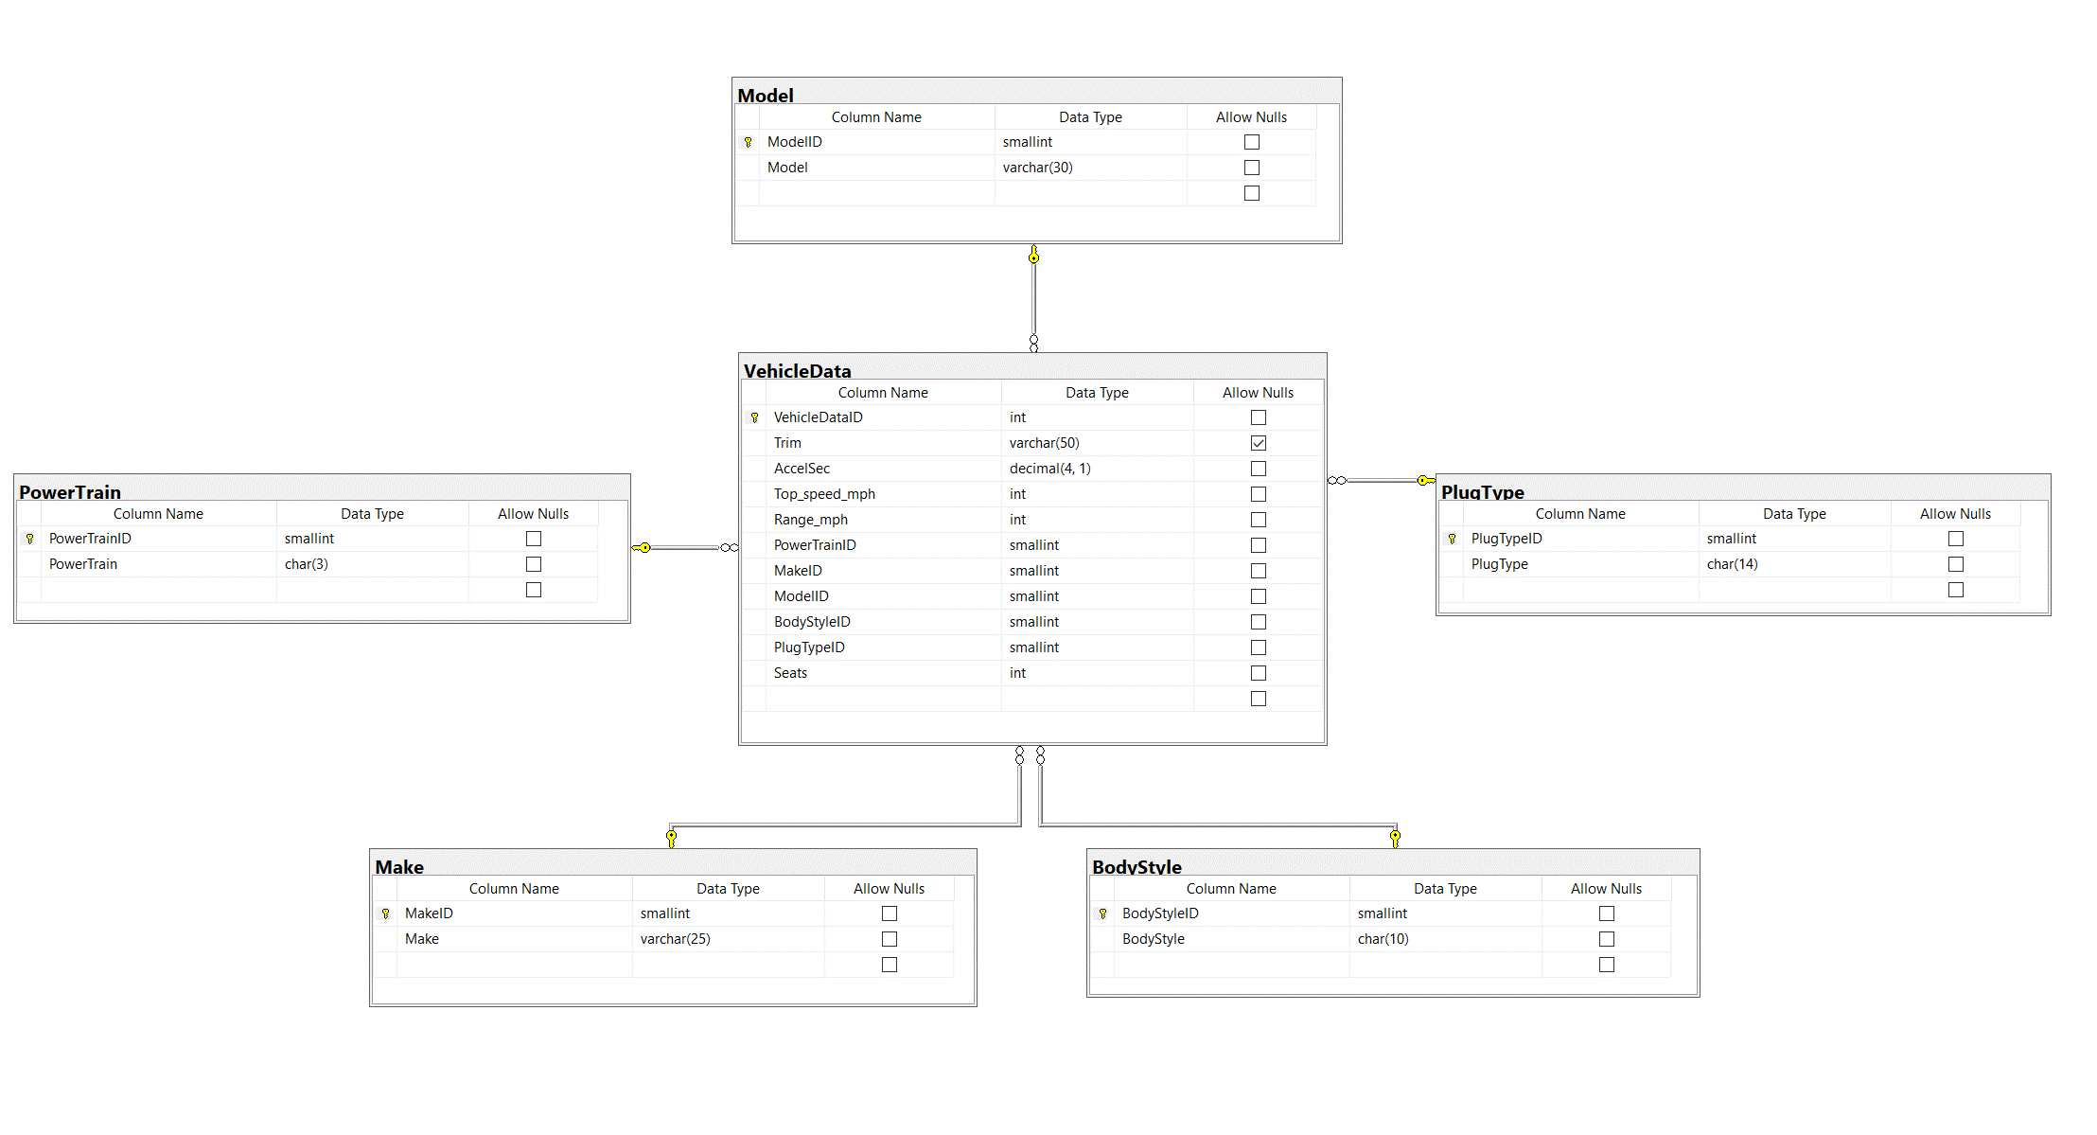
Load: Entity Relationship Diagram (ERD)
Our ERD provides a visual method of modeling the data.

Slide 14
Load: SQL Data Normalization
We used the Data normalization process to restructure data to a
set of “normal forms.”
First Normal Form (1NF):
Raw Data
1NF
Normalization
HOLD FOR PIC
HOLD FOR PIC
Second Normal Form (2NF):
Data in 1NF
Child Table
2NF Normalization
Family Table

Slide 15
Load: Tables and Collections

Slide 16
Load: Final Database

Slide 17
Project Summary – Project Limitations
Xx
Xx

Slide 18
Sources
https://www.kaggle.com/geoffnel/evs-one-electric-vehicle-dataset?select=ElectricCarData_Clean.csv
https://www.caranddriver.com/shopping-advice/g32463239/new-ev-models-us/

Slide 19
THANK YOU

